Slide 1
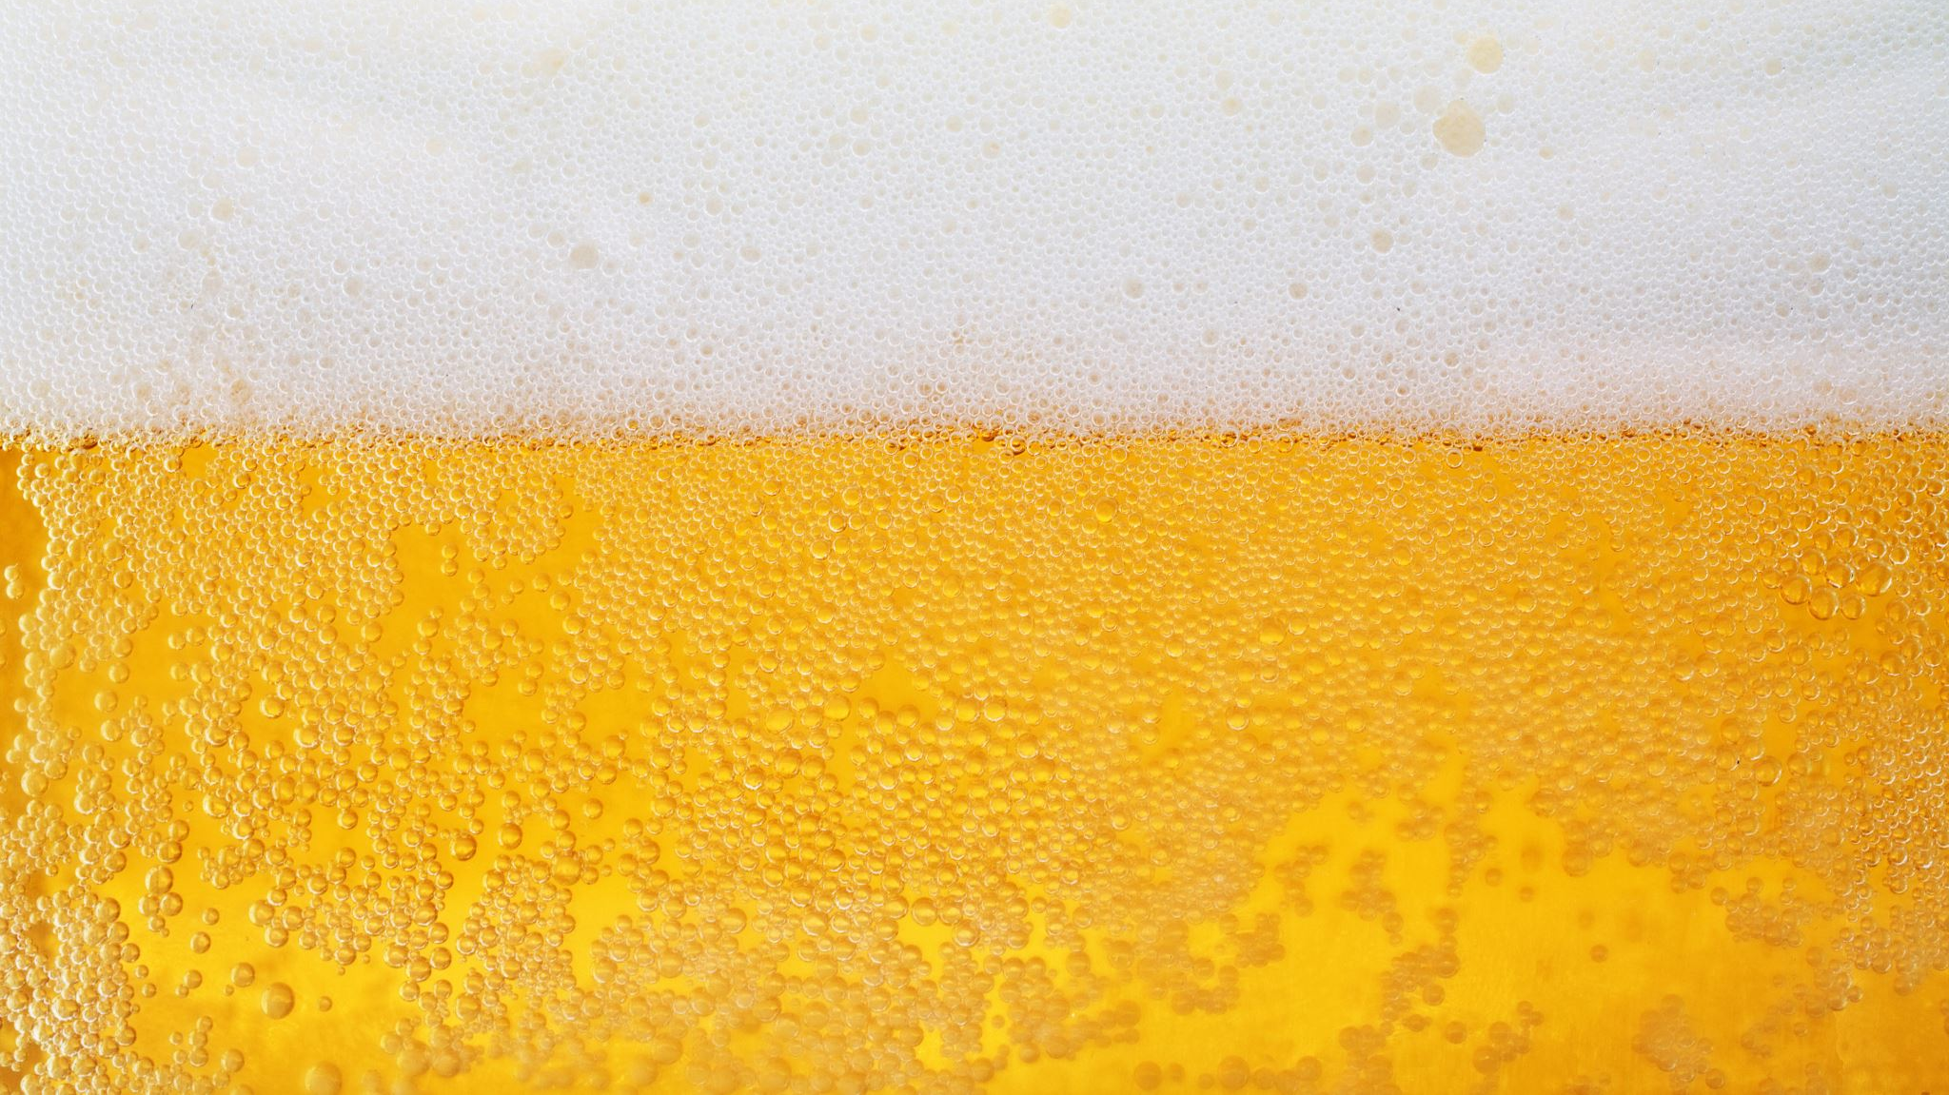
Brewing the next great NA Beer
Using data on different beer styles to brew the next NA beer

Slide 2
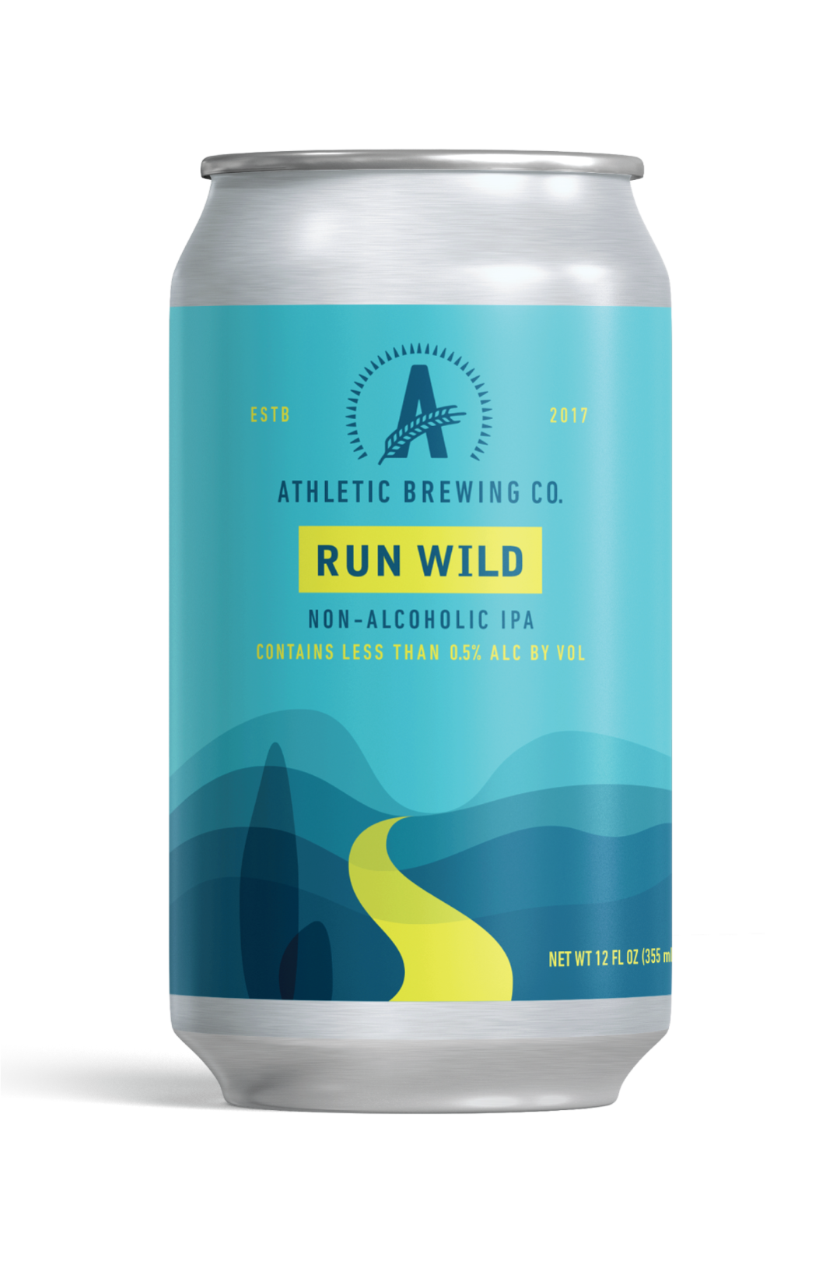
Introduction
Customer is Athletic Brewing Company
Only make non-alcoholic beer
Focus on quality beers that taste good
Over 20 NA beers in their portfolio
Company with a focus on customer’s health, fitness and happiness
Environmentally focused
Goal of the project- Assess craft beer information to identify next beer type/flavor profile to add to their portfolio.

Slide 3
Why is this important
6% of adults have an alcohol use disorder
1/12 men and 1/25 women.
88,000 people die of alcohol related causes every year (Drunk driving, alcohol abuse etc.)
Alcohol is very prevalent in our culture, which makes it harder to tell when someone has a problem or is addicted.
Things preventing people from recognizing they have an issue:
TV/movies glamorizing and normalizing alcohol use and abuse.
Social situations make it hard to not drink when everyone else is drinking.
Alcohol generally tastes good.
Athletic helps with these 2
Biological Sex | Drinks in a single day | Drinks in a week
Men | >4 | >14
Women | >3 | >7

Slide 4
What was used
Data used:
Tools used
Beer Profile and Ratings Data Set on Kaggle
https://www.kaggle.com/datasets/ruthgn/beer-profile-and-ratings-data-set
3000+ Unique beer
25 rows per beer detailing things like:
Tasting profiles
Reviews
Beer styles
ABV
This would be a predictive data project, because the goal is make a popular beer.
Data from Kaggle
Microsoft Excel
Clean the data
Add relevant columns
Delete unnecessary rows
Utilized Pivot Tables to assess relationships between components
Tableau
Create visuals
Asses the data

Slide 5
Data cleanup, spreadsheet processes/analyzing
Unique or rare beer types were removed to reduce number of beer styles
Similar beer styles were combined to reduce number of beer styles (ex. Blonde Belgian and Blonde American were combined.
Used Pivot tables to quickly see relationships between components.
Used filters to remove rows

Slide 6
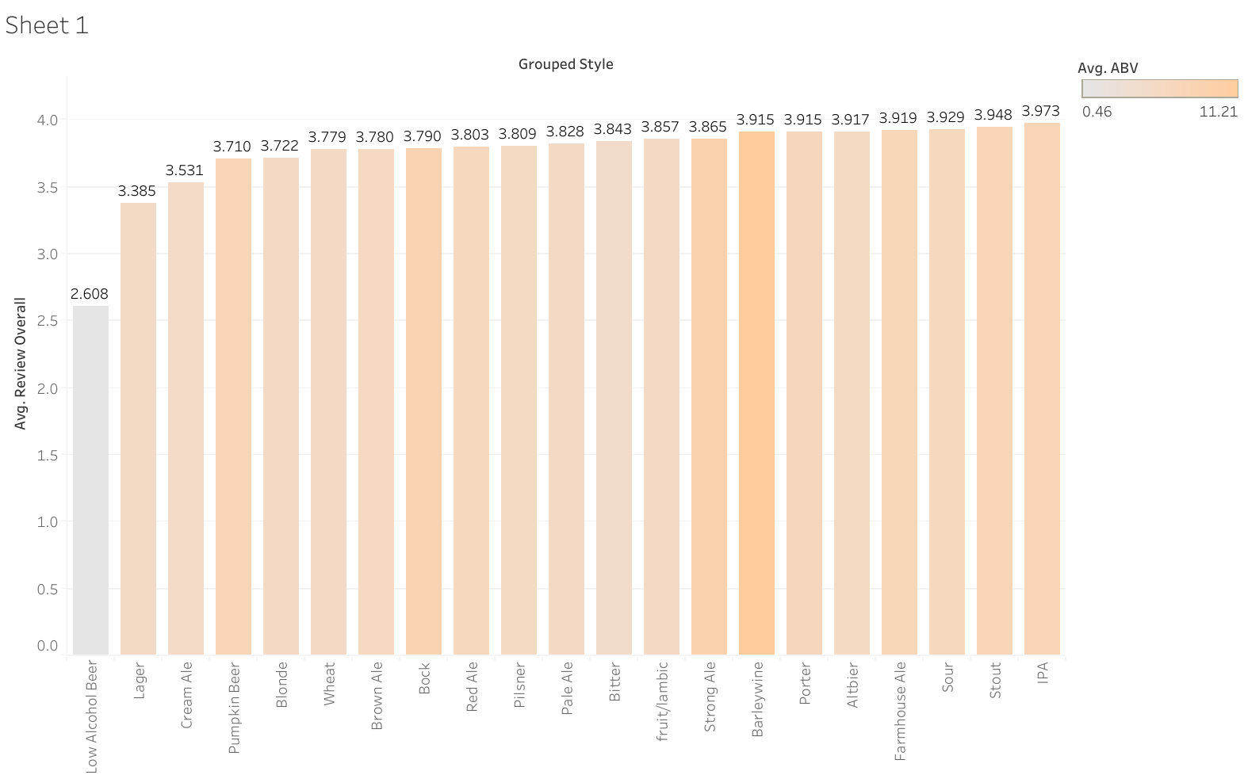
Popularity of different beers

Slide 7
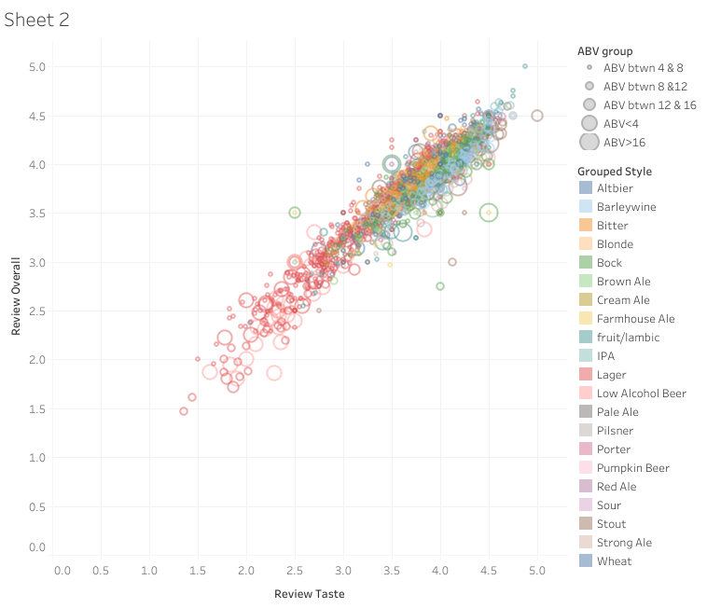
Taste vs rating

Slide 8
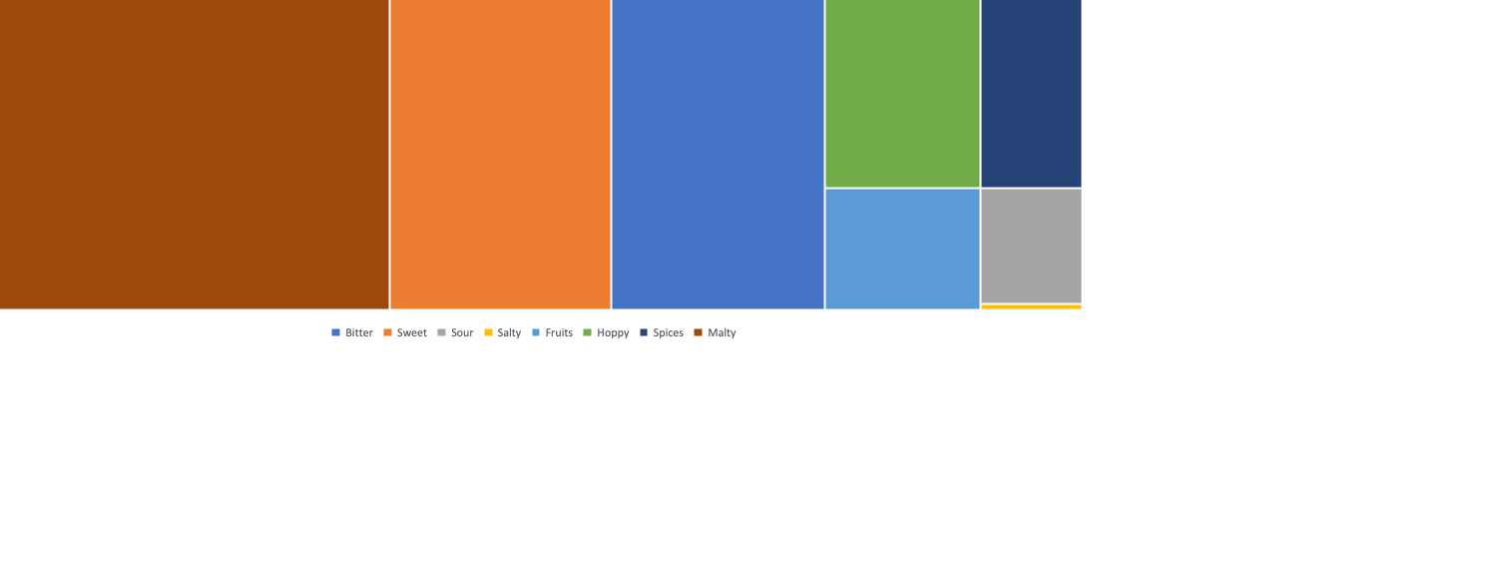
What makes a good Stout?
Bitter | Sweet | Sour | Salty | Fruits | Hoppy | Spices | Malty
64.696 | 67.256 | 10.752 | 0.552 | 17.384 | 30.136 | 19.464 | 124.416

Slide 9
Next Steps- how to validate
Develop
Develop new NA Stout that is very Malty, with either sweet or bitter taste.
Taste
Taste test, compare to other stout rankings
Refine
Refine flavor profile to a specific Stout style (oatmeal, American Stout, etc.)
Many of the highest rated stouts get flavor from a bourbon barrel. Coffee stout might be a good style to emulate.
Drink!
Drink and perform more taste test!

